Slide 1
实验三 单周期MIPS处理器设计参考实现

Slide 2
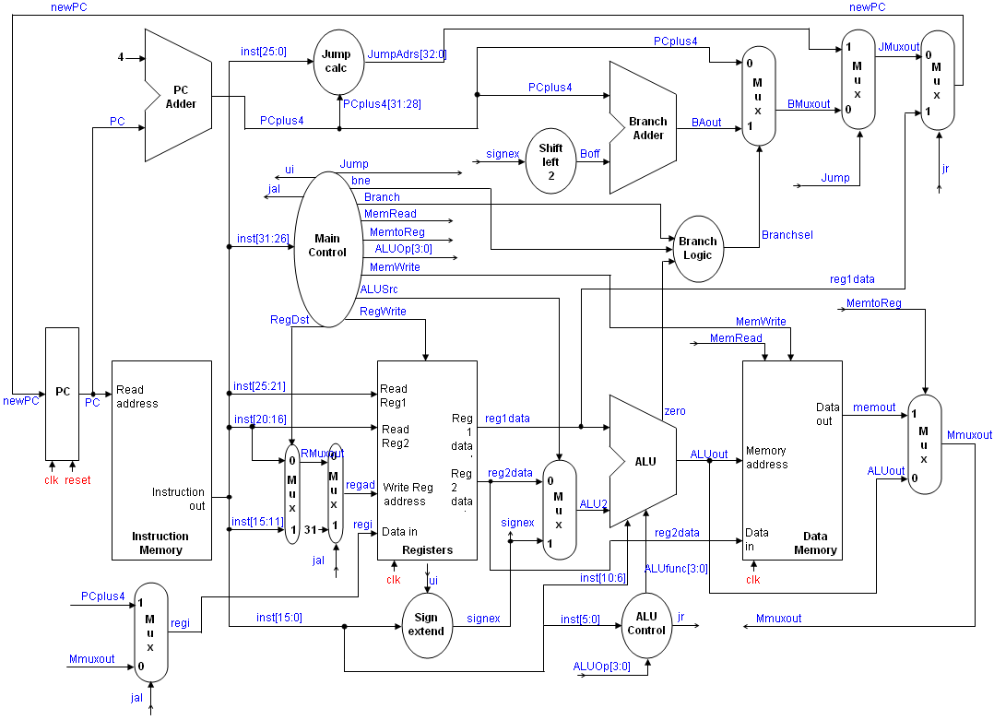

Slide 3
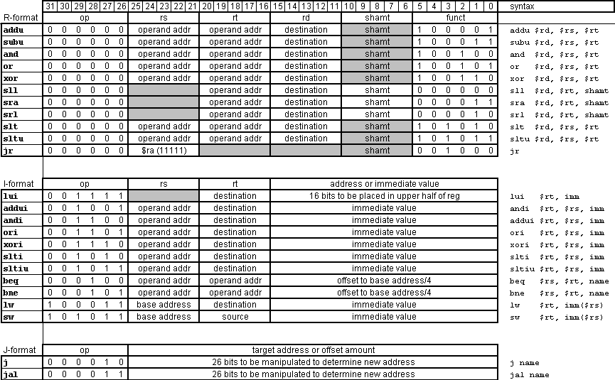
instructions.

Slide 4
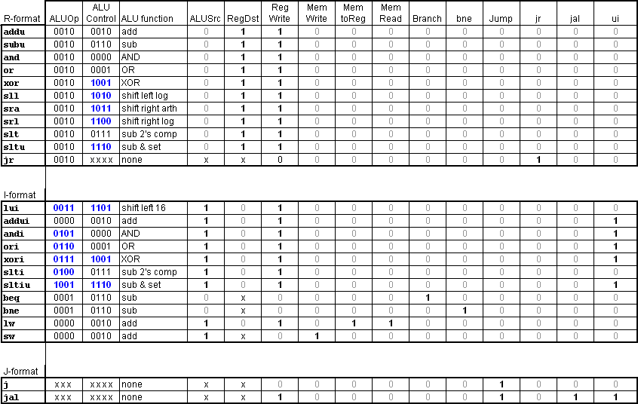
Control signals

Slide 5
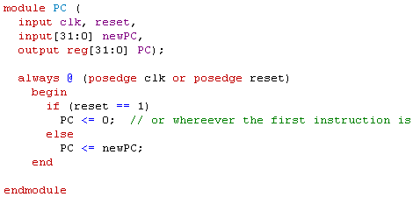
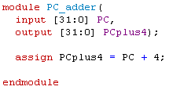

Slide 6
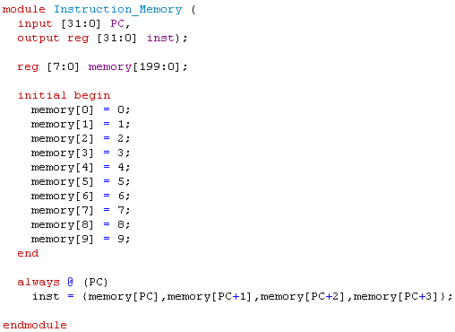

Slide 7
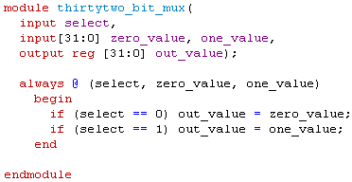
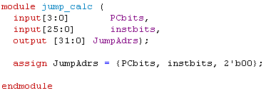

Slide 8
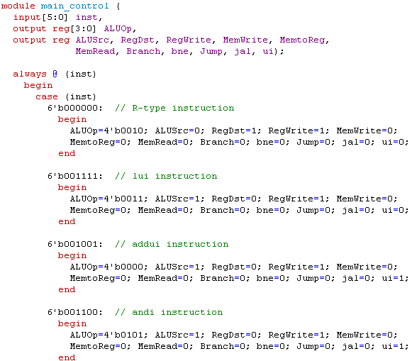

Slide 9
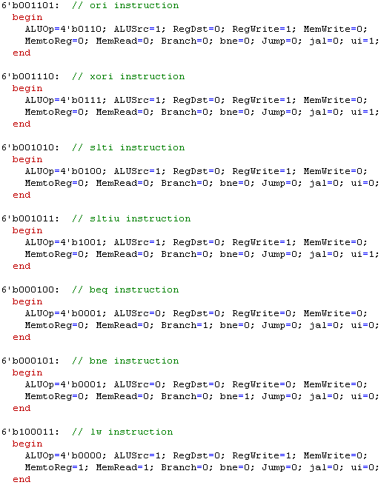

Slide 10
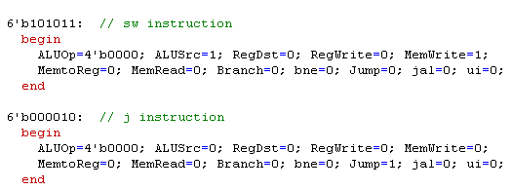
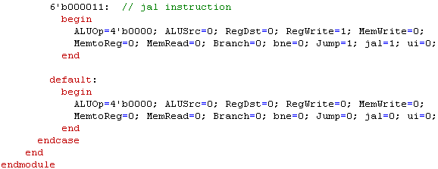

Slide 11
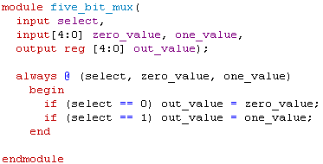
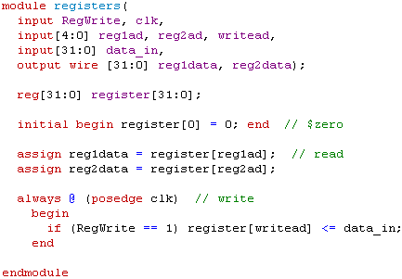

Slide 12
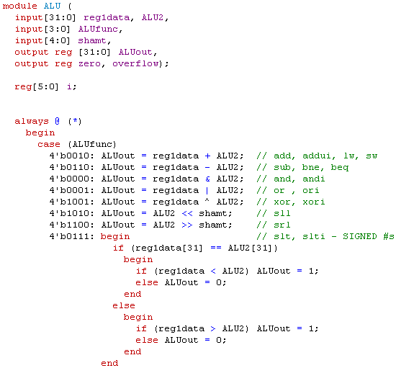

Slide 13
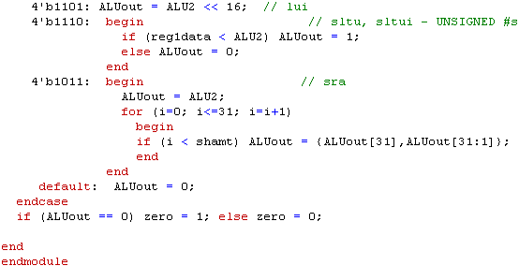

Slide 14
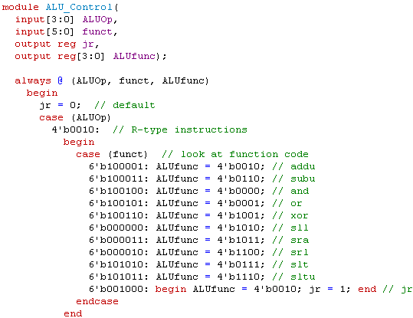

Slide 15
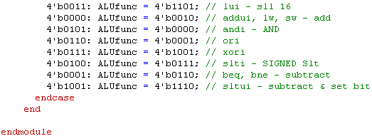

Slide 16
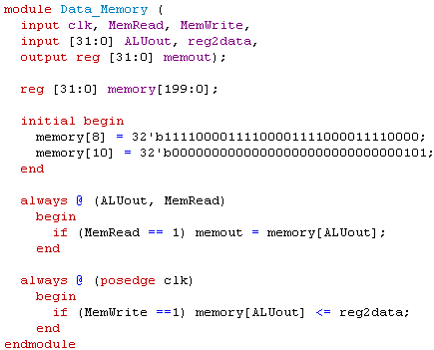

Slide 17
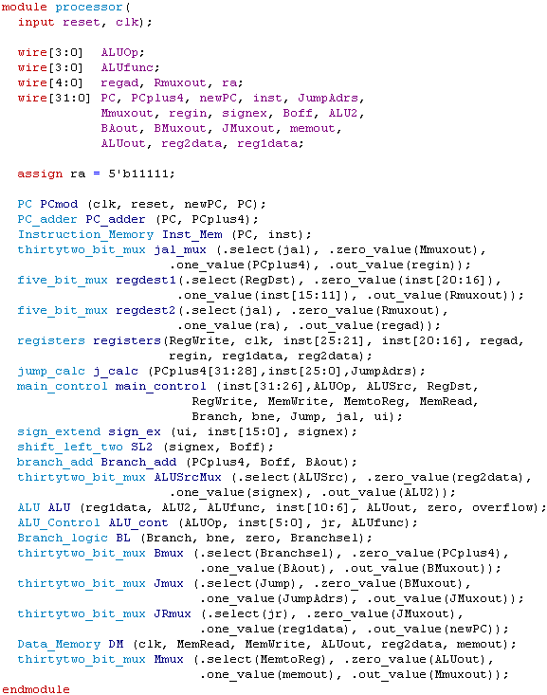

Slide 18
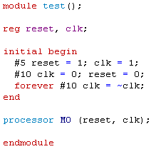

Slide 19
Test
Add unsigned, addu:
simply tell it to add $r1 to $r2 and place the results in $r3, which will be a code of:
000000 00001 00010 00011 00000 100001
It worked!
set $r1 = 01010101….., and $r2 = 10101010…..
At the first positive edge of the clock reg1ad = 1, reg2ad = 2, RegWrite = 1, writead = 3, and the ALU must have performed the addition because regin = 11111111….. Further, on the next positive edge of the clock you can see that the result is written to register[3], as intended.
Run the second clock just to verify the results.

Slide 20
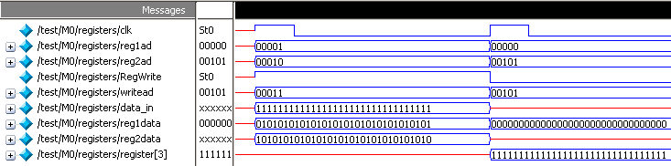
addu

Slide 21
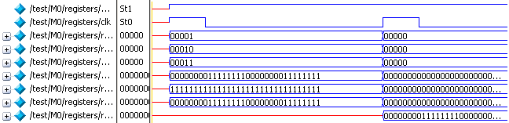
and

Slide 22
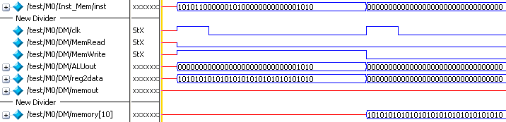
SW ; MemWrite is asserted
This instruction stores reg2data to memory address 10, i.e., memory[10]
Also note the ALU calculates the memory address for store; so ALUout is the memory address which is 10, 1010 in binary

